Slide 1
Biweekly Update
March 20, 2023
The Little Engineers that Could: Blake, Sam, Melanie, and Amy

Slide 2
Part | Quantity | Price
Fiberglass Insulation | 1 | $35.20
IronHorse Motor | 1 | $232.00
IronHorse Gearbox | 1 | $139.00
IronHorse output shaft | 1 | $16.50
12V 120mm fan | 3 | $60.00
PWM controller | 3 | $48.00
PID Temp controller w/accessories | 3 | $120.00
Shaft coupling | 1 | $153.12
6” and 12” heaters | 3 | $81.83
Power Supply | 1 | $13.00
Incoming Power | 1 | $19.85
Total Cost:
$918.50

Slide 3
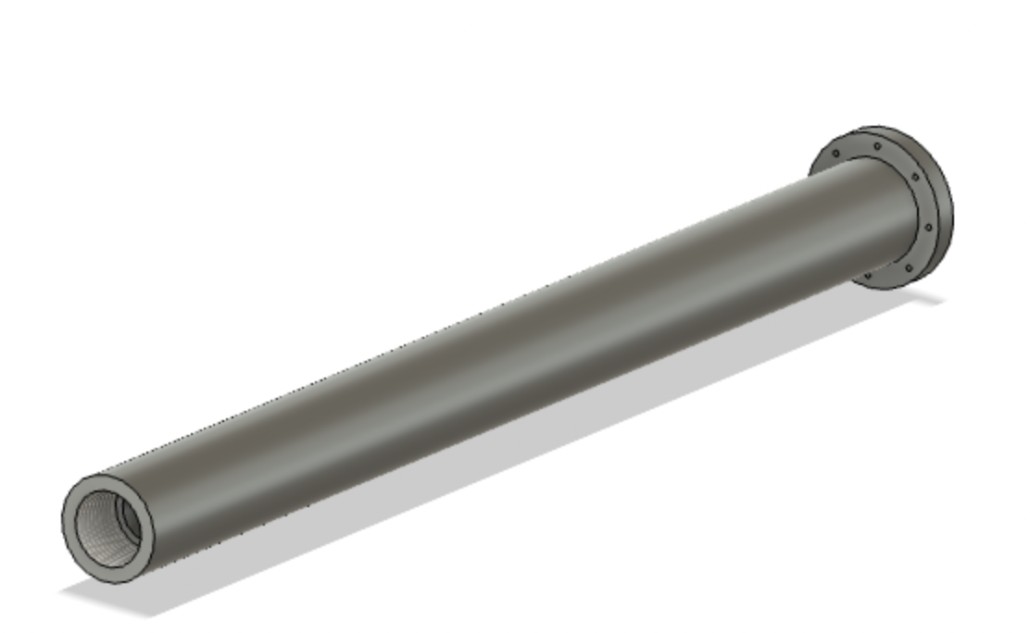
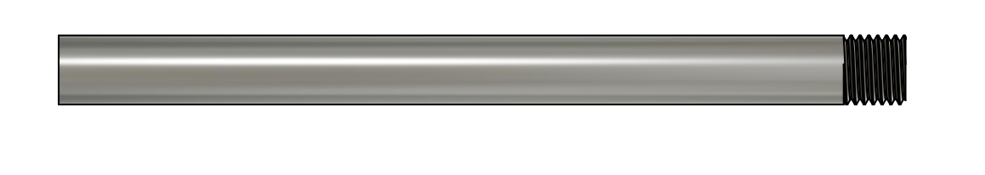
Barrel
We saw David’s updated barrel design
We are unsure whether we need to change our CAD for the flange/other components to conform to the new barrel design
Have we heard back from TCAT on progress/cost?
Old
New

Slide 4
Housing
We have made fully assembled housing in Fusion
We are not sure whether David has been able to access the file yet
It is in 6 separate pieces that we can bolt together, and SendCutSend accepts up to 10 CAD files for an order
Question: Are we attaching things to the bottom of the housing? For example, the motor has holes to bolt it to something. Are we going to use those and screw it through the bottom of the housing, or have a mount attached to the bottom housing to screw into?

Slide 5
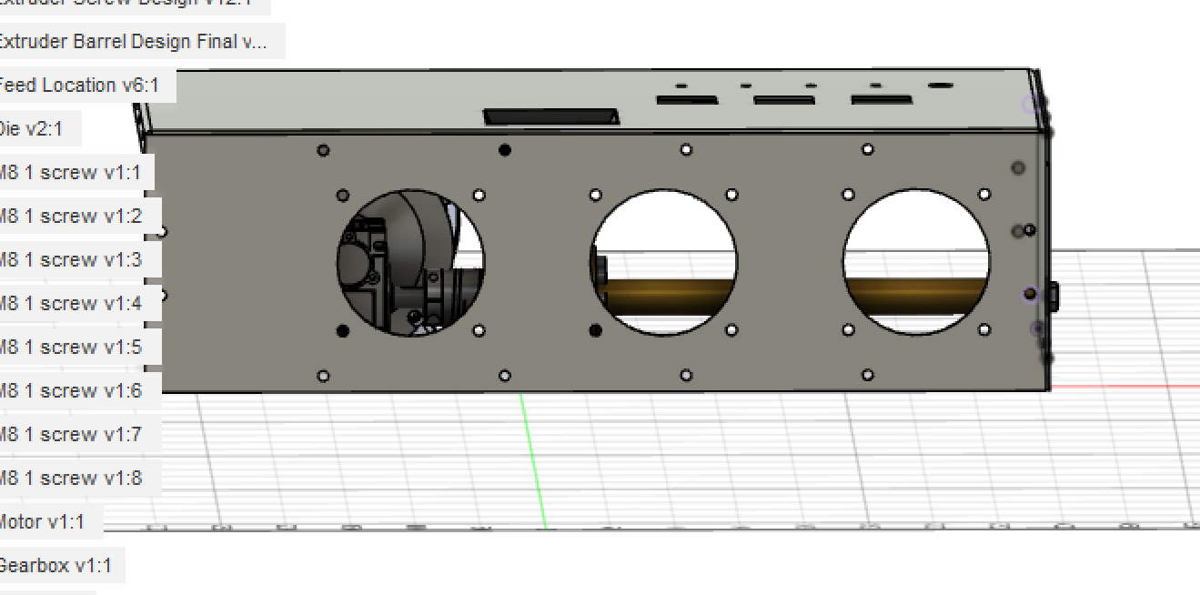
Fans
Do we need 3 fans? Or 4? David said we need an additional fan for the feed section, but will it be hot?
The fans david sent us are pretty big, there isn’t even really room for 4 fans

Slide 6
Action Items/Questions
Meeting with David tomorrow – finalize housing and ordering VFD
TCAT visit ?
Team Meeting to reorient

Slide 7
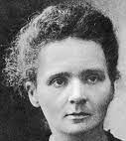

“To infinity and beyond”
Marie Curie

